Slide 1
Requirements:
A machine that can give a user a high five
After receiving a high five, the robot needs to say “Good Job” and put it’s hand down for 5 seconds before raising it’s hand again, signifying that it wants another high five.
Continuously ask the user for a high five.
The program can only be terminated from the brick.
If after 10 seconds, the user does not give a high five, the robot must say “please” every 5 seconds until the user high fives the robot, then the cycle is reset.`

Slide 2
Morph Chart
Requirements | Means
Sense High Five | Touch sensor in “palm” | Movement of motor | Touch sensor behind “arm”
“Arm” | Bar attached to motor | Technic bricks – straight | Technic bricks – bent
“Hand” | Square lego | Square lego, trapezoidal lego, tube pipes (“fingers”) | Claw pieces

Slide 3
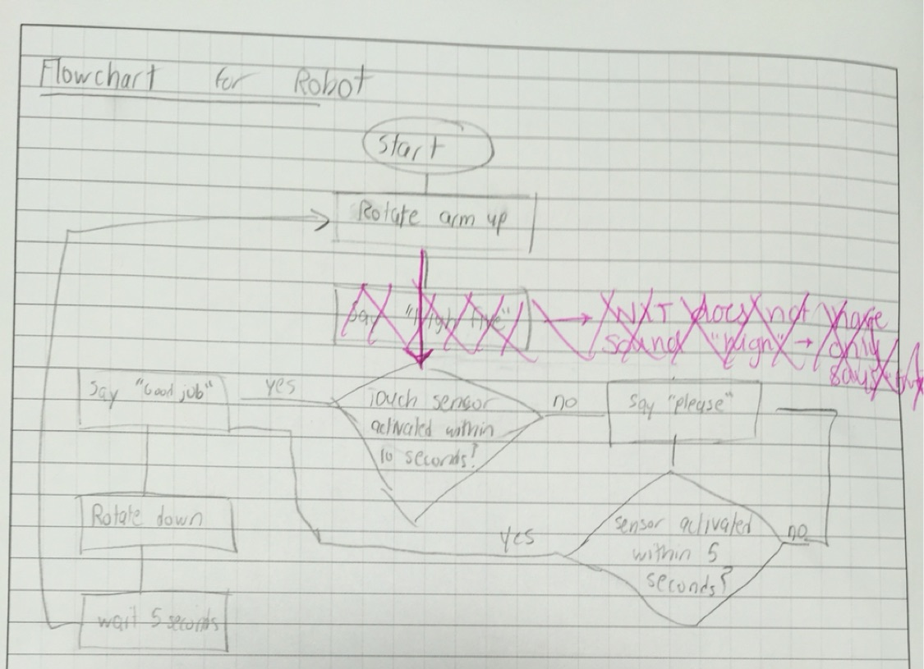
Logic

Slide 4
Testing
Trial Number | Time for First Please (seconds) | Touch sensor activated? | Time in parallel position (seconds) | Remarks
1 | 10.5 | No | 5.42 | Pressure too light for robot to sense
2 | 9.8 | Yes | 5.53 | Pressure was hard, but robot did not break
3 | 10.5 | Yes | 6.12 | Pressure was hard, but hand did not break
4 | 10.4 | No | 5.60 | Pressure was hard, but the timing was incompatible with logic
5 | 10.3 | Yes | 5.55 | Pressure was hard, but hand did not break
6 | 10.2 | No | 5.58 | Pressure was hard, but the timing was incompatible with logic

Slide 5
Problems
Robot waits 10 seconds, checks for touch sensor depression.
If the touch sensor was depressed before this check, the robot does not register the high five, and says “please”.
Any time after this, the high five is detected correctly.
This problem was later resolved.
Robot is unstable, prone to falling over

Slide 6
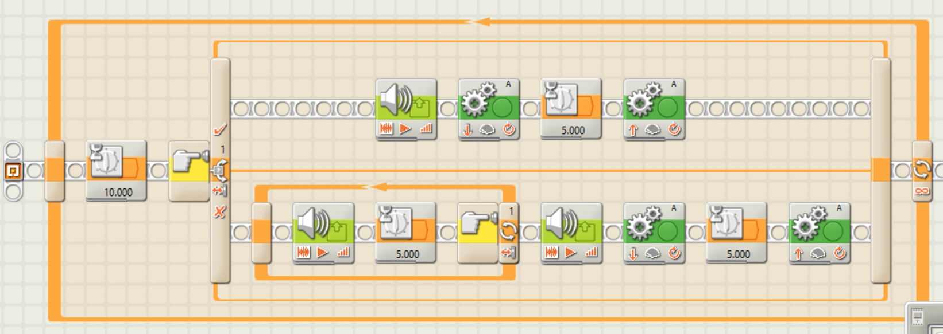
Final Code/Logic

